Slide 1

^{Navigating School Safety with}
^{Neurodivergent Students}
Presented by Johnny Weigel, Prevention Services Account Manager
WORKING TOWARD A SAFER SASKATCHEWAN

Slide 2
Violence
3‑26(1) In this section, “violence” means the attempted, threatened or actual
conduct of a person that causes or is likely to cause injury, and includes any
threatening statement or behavior that gives a worker reasonable cause to believe
that the worker is at risk of injury.
Notes:
SK OHS Regs Sec 3-26.
SK Employment Act Sec 3-21. A policy statement and prevention plan required. This includes hazard id and control, communication, investigations, worker support, etc.
SK OHS legislation does not distinguish between responsive behaviors and intentional acts of violence.

Slide 3
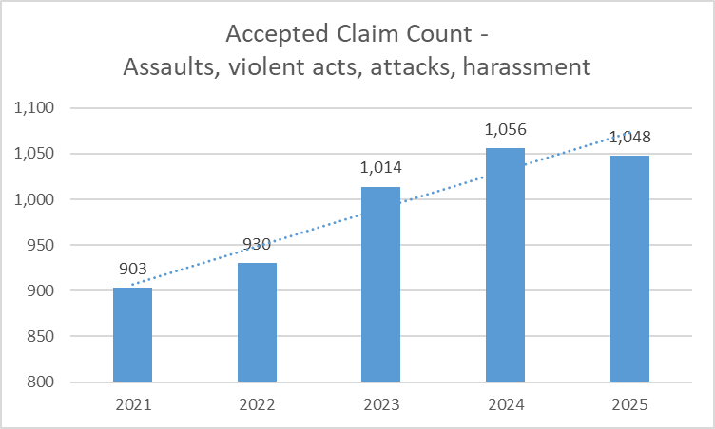
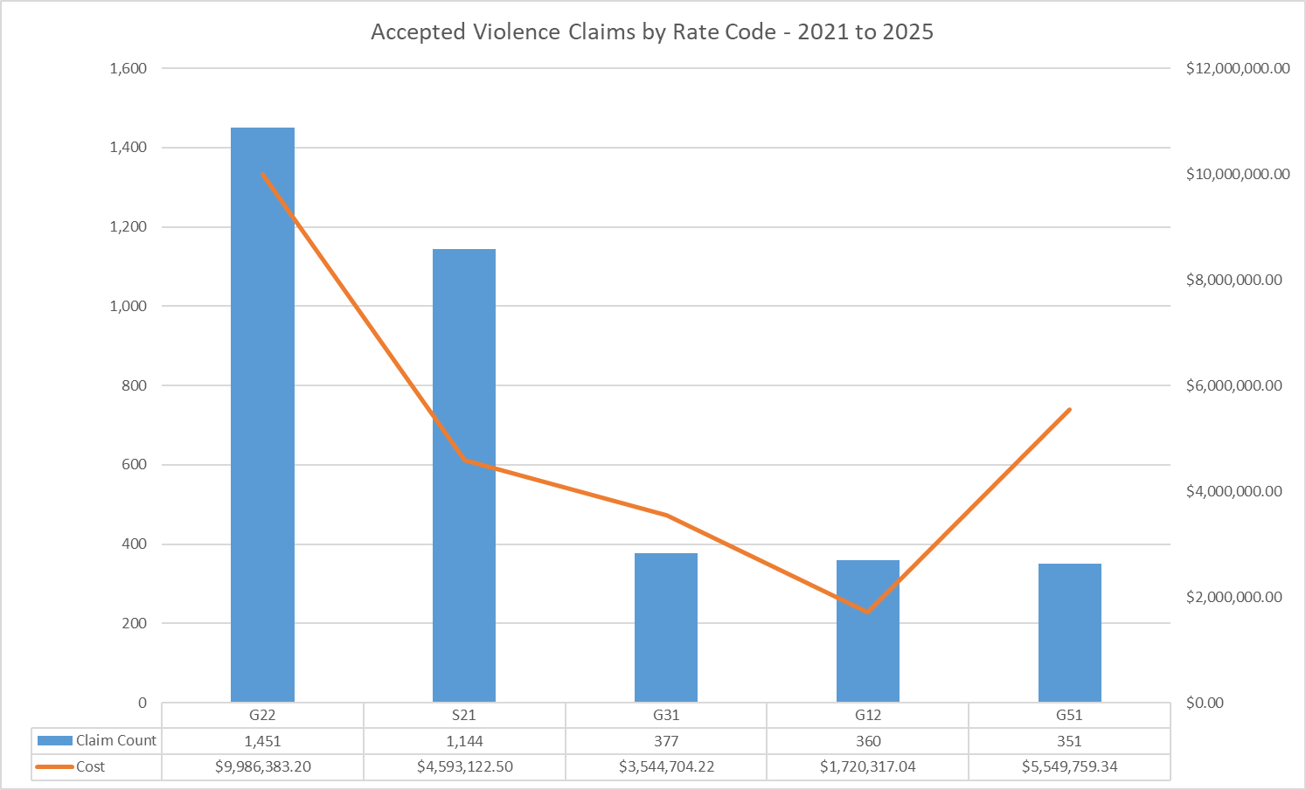
Workplace violence in Saskatchewan workplaces…
Notes:
*Accepted claims. Employer Fund. Assaults, violent acts, attacks, harassment. Eff Feb 1, 2026.
Workplace violence has seen a steady increase in accepted claims over the years of 2021 to 2025.
If we are to compare against other industries… we see that G12 is the fourth highest for accepted claims. Representing 7.27% of the claim count and 4.51% of the claim costs between 2021 and 2025.
It’s not a surprise to see primary/secondary education in the top 5. Like healthcare, community services, first responders and corrections, human behavior serves as a primary driver of safety risks for staff.
G22 – Health Authority, Hospitals and Care Homes
S21 – Community and Social Services
G31 – Cities, Towns, Villages and RMs
G12 – Elementary and Secondary Education
G51 – Government of SK and Ministries

Slide 4
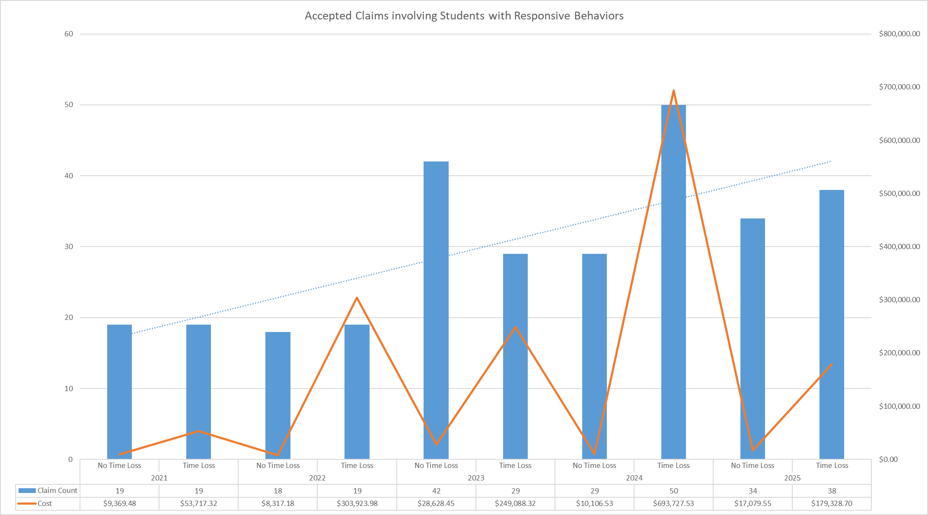
How is workplace violence trending in Saskatchewan schools?
Notes:
*Accepted claims. Employer Fund. G12. Assaults, violent acts, attacks, harassment. Student. Eff Feb 1, 2026.
Claims associated with violence in SK schools are trending upwards.
This data does not include incidents where there was no medical or near misses. Nor does it account for under reporting, which we know can be an issue in workplaces where violence is seen as “just part of the job.”
In school settings, safety is often impeded by the unpredictable nature of student and community behavior:
Student Escalation: Behaviors that pose an ongoing risk of injury to staff require formal Student Safety Plans to outline crisis-response roles for workers.
Unclear Behavioral Expectations: A lack of explicitly stated Codes of Conduct for students, staff, and visitors can lead to inconsistent responses to threatening behaviors, increasing the risk of traumatic incidents.
Reactive Safety Cultures: Policies that focus on reacting to extreme violence rather than proactive prevention and positive school climates often fail to identify early triggers of staff-targeted aggression.

Slide 5
Defining “Responsive Behaviors” in the School Setting
Behaviors that arise from unmet needs, emotional dysregulation or neurological differences. For example, Autism Spectrum Disorder (ASD), Attention-Deficit/Hyperactivity Disorder (ADHD), Dyslexia, Dyspraxia, Dyscalculia, Tourette Syndrome, and Obsessive-Compulsive Disorder (OCD) .
These behaviors can often disrupt learning and place the student or others at risk of harm.
* SK OHS legislation does not distinguish responsive behaviors from intentional acts of violence.
Notes:
Neurodivergent describes people whose brains function, learn, and process information differently than what is considered typical (neurotypical). It is a non-medical, umbrella term often covering conditions like autism, ADHD, dyslexia, and Tourette syndrome. Rather than indicating a deficit, it represents a natural variation in human neurological functioning.
* Responsive behaviors are not deliberate misbehaviors.
Autism Spectrum Disorder (ASD) is a lifelong neurodevelopmental condition affecting brain development, characterized by persistent challenges in social communication, interaction, and restricted, repetitive patterns of behavior or interests.
ADHD is a mental condition, beginning in childhood and often persisting into later life, that is characterized by persistent difficulty in maintaining attention and concentration, and is frequently accompanied by hyperactive and impulsive behavior.
Dyslexia is a condition of neurodevelopmental origin that mainly affects the ease with which a person reads, writes, and spells, typically recognized as a specific learning disorder in children.
Dyspraxia, often called Developmental Coordination Disorder (DCD), is a lifelong neurodevelopmental condition affecting physical coordination, motor planning, and movement. It causes difficulties with fine motor skills (writing, tying shoes), gross motor skills (running, jumping), and organization, while often impacting speech and sensory processing.
Dyscalculia a condition of neurodevelopmental origin that causes difficulty in performing arithmetical calculations.
Tourette Syndrome (TS) is a neurodevelopmental disorder characterized by involuntary, repetitive, and sudden movements or vocalizations known as tics.
Obsessive-Compulsive Disorder (OCD) is a mental health condition characterized by a cycle of unwanted, intrusive thoughts (obsessions) that cause significant anxiety, leading individuals to feel driven to perform repetitive behaviors or rituals (compulsions) to temporarily relieve that distress, often taking up significant time and interfering with daily life.

Slide 6
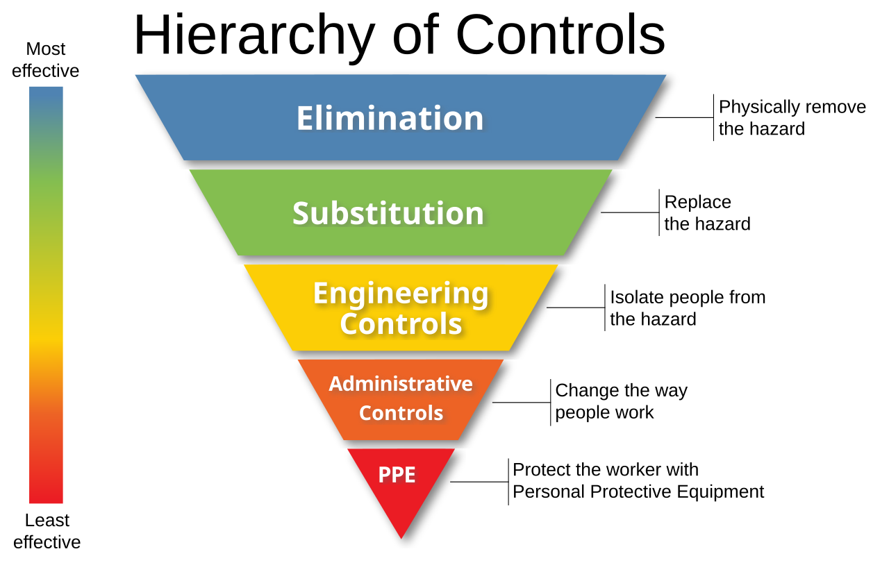
What controls exist to promote staff safety?
Notes:
Responsive behaviors are not always predictable. This fact combined with the nature of teaching makes staff safety incredibly difficult.
For instance, in manufacturing if a saw presents a risk of hand injuries one simply installs a guard to prevent hand access to the blade.
Neurodivergent student behaviors are not so simple.
Let’s apply the hierarchy of controls to this issue.
First off, we can remove substitution. We can not substitute students like we would substitute a hazardous chemical for one that is non-hazardous.

Slide 7
Elimination?
Under Section 178(4) of the Education Act, 1995, a student with intensive needs cannot be suspended or expelled if their behavior is considered part of their condition.
Principals can typically issue suspensions of three to ten days for "overt opposition" or "serious misconduct" that poses a risk to health or safety. However, schools tend to favor rehabilitative over punitive discipline.
Approximately 1 in 9 students with intensive support needs were excluded from school on a part-time or full-time basis in the 2024-25 school year.
  Exclusions are primarily attributed to funding decisions, lack of staffing, behavioral support gaps, and barriers in accessible transportation.
Specialized Support Classrooms may be a solution to manage learning disruptions. However, these classrooms can also be viewed as a form of seclusion.
Notes:
Similarly, elimination can also be removed from consideration. In SK, the removal of intensive needs students from the classroom is not encouraged.
https://www.inclusionsk.com/post/unseen-impacts-the-reality-of-school-exclusion-for-students-with-disabilities-in-Saskatchewan
https://www.inclusioncanada.ca/post/inclusion-saskatchewan-and-inclusion-canada-outraged-at-government-of-saskatchewan-s-announced-expan

Slide 8
Engineering?
The classroom should encourage calmness.
  Examine lighting, acoustics, barriers/zones, and clutter.
  Sensory retreat areas or a Snoezelen room.
To minimize the impact of escalated behaviors one should consider:
  Weighted or bolted furniture.
  Safety glass or film to prevent shattering.
  Corner guards on edges of furniture.
  De-escalation rooms that provide a low-stimulation environment where a student can act out physically without harming themselves or others.
  Time-delay or magnetic door locks.
  Split-level doors.
Notes:
Lighting Adjustments: Replacing harsh fluorescent lights with warm LED bulbs or natural lighting reduces visual strain and overstimulation.
Acoustic Management: Using sound-absorbing acoustic panels, thick rugs, or noise-cancelling headphones minimizes auditory overload.
Zoning & Barriers: Creating defined "zones" for group work vs. quiet tasks using bookshelves or room dividers helps students understand expectations for each space.
Reduced Visual Clutter: Limiting wall decorations to 30–50% coverage and using closed storage bins for unused materials prevents cognitive fatigue.
Snoezelen Multi-Sensory Environments | Sensory Rooms and ...A Snoezelen room is a specialized, controlled multi-sensory environment designed to provide calming or stimulating sensory experiences for individuals with autism, dementia, brain injuries, or developmental disabilities. Using elements like fiber optics, bubble tubes, soothing sounds, and aromatherapy, these rooms help reduce anxiety, manage challenging behaviors, and foster relaxation.

Slide 9
Administrative?
Inclusion and Intervention Plans.
Case conferences.
Staff rotation.
Emergency procedures. E.g., Classroom Evacuation Protocols.
Incident reporting.
Training:
  Non-Violent Crisis Intervention (NVCI), Mental Health First Aid (MHFA), Professional Assault Response Training (PART), Therapeutic Crisis Intervention (TCI), Critical Incident Stress Management (CISM), or Children and Residential Experiences (CARE).
Notes:
Inclusion and Intervention Plans (IIP): The primary administrative tool for students with intensive needs. These plans document a student’s strengths, triggers, and measurable outcomes, ensuring all staff follow a consistent response protocol during an escalation.
Personnel Protocols
Case Conferences: Frequent administrative meetings between teachers, parents, and occupational therapists or psychologists to adjust a student's environment before behavior reaches the point of violence.
Staff Rotation: To prevent burnout and maintain a high level of patience—critical for neurodivergent students—administrators may rotate staff or schedule frequent breaks for teachers and EAs working in high-intensity classrooms.
Training
Specialized Training (NVCI): Many divisions require staff to be trained in Non-Violent Crisis Intervention (NVCI) or similar de-escalation frameworks. This administrative control ensures staff use "rational detachment" to manage their own reactions and minimize student agitation.
Mental Health First Aid (MHFA)
The MHFA Canada program aims to improve mental health literacy and provide the skills and knowledge to help people better manage potential or developing mental health problems in themselves, a family member, a friend, or coworker.
Professional Assault Response Training (PART)
PART training provides workers with an understanding of, and the ability to assess, potentially violent situations and a means to manage, reduce or eliminate risks. PART interventions (e.g., verbal crisis intervention, breakaway, evasion, manual restraint techniques) can be used when the primary and back up plans fail, and workers are faced with an immediate threat of injury.
Gentle Persuasive Approaches (GPA)
GPA safety training is designed to equip healthcare staff and students with the skills and knowledge to care for individuals safely and effectively with dementia. It focuses on understanding the challenges of Alzheimer's and dementia, applying communication strategies to diffuse challenging behaviors, and using respectful protective techniques when necessary.
Therapeutic Crisis Intervention (TCI)
TCI training is a crisis prevention and intervention model that focuses on helping organizations prevent crises, de-escalate situations, and effectively manage crises, all while minimizing potential harm to children/youth and staff. It teaches staff constructive ways to handle stressful situations and promotes a learning environment where individuals can develop coping mechanisms.
Critical Incident Stress Management (CISM)
CISM training is a comprehensive system of crisis intervention designed to mitigate the psychological impact of traumatic events, often used in workplaces and communities. It aims to help individuals and groups process stressful situations, manage reactions, and promote recovery. CISM training equips individuals with the skills to provide short-term, supervised crisis intervention, but it's not a replacement for mental health therapy.
Children and Residential Experiences (CARE)
CARE is a principle-based program model that provides organizations a framework for practice based on a valid theory of how children develop. It motivates children and staff to adhere to routines, structures, and processes while minimizing the potential for interpersonal conflict.

Slide 10

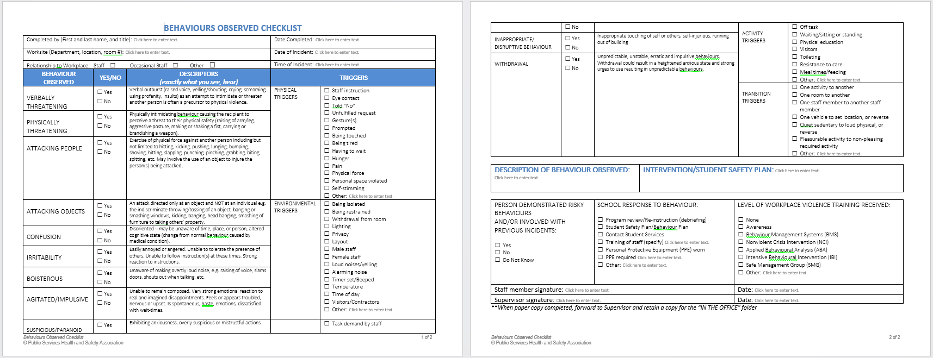
Administrative?
Complete a Workplace Violence Risk Assessment.
Individual Student Risk Assessments.
In the moment risk assessments of self, student, and environment.
Generate Confidential Staff Safety Alerts.
Implement a Personal Safety Response System.
Notes:
Resources
Workplace Violence Risk Assessment Toolkit (adapted from PSHSA’s healthcare workplace violence risk assessment) - https://www.pshsa.ca/workplace-violence-risk-assessment-toolkit-for-the-education-sector. Designed to help identify and address potential hazards and risks.
Individual Client Risk Assessment - https://workplace-violence.ca/tools/individual-client-risk-assessment/
Personal Safety Response System - https://workplace-violence.ca/tools/personal-safety-response-system/
https://www.pshsa.ca/resource/violence-assessment-education/

Slide 11
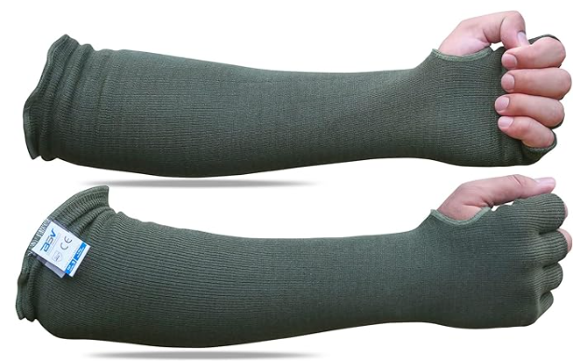
Personal Protective Equipment (PPE)?
Kevlar sleeves, gloves or jackets/hoodies.
Spit shields and padded vests.
Be aware… while PPE can protect staff from violence, it can also be seen as undermining inclusion.
Notes:
PPE is considered the last line of defense.
Occupational Health and Safety (OH&S) in SK schools classifies certain wearable engineering controls as mandatory for staff working with aggressive behaviors.
While PPE can protect staff from violence, it can also be seen as undermining inclusion.
Can escalate the “fight or flight” response.
Breakdown trust.
Impact tactile and auditory sensitivities.
It may signal to other students that their peer is dangerous.

Slide 12
The truth is error is inevitable… and is driven by:
Fatigue and stress.
Psychological safety.
  Culture drives behavior.
    Blame fixes nothing.
    Leadership response is critical.
    Learning is vital.
Notes:
Human and Organizational Performance (HOP) is a mindset and operational philosophy that shifts the focus from "fixing the worker" to "fixing the system." It acknowledges that while human fallibility is inevitable, organizations can build resilient, error-tolerant systems by understanding how people and processes interact.
The framework is built upon five core principles pioneered by Dr. Todd Conklin:
Error is Normal
Mistakes are a natural part of being human. Because they are inevitable, the goal is not to eliminate them entirely—which is impossible—but to design systems that can anticipate and withstand errors without catastrophic failure.
Blame Fixes Nothing
Focusing on who to blame creates a culture of fear that discourages honesty and hides systemic issues. Removing blame allows for open reporting, which is the only way an organization can truly understand and address the root causes of failure.
Context Drives Behavior
People don't act in a vacuum; their decisions are shaped by the workplace culture, available resources, and system design. To change how people work, you must first understand and improve the operational context that influenced their actions.
Learning is Vital
Improvement requires a deliberate and continuous effort to learn from both failures and "normal work." Successful organizations use Learning Teams to gain insights from those who actually perform the tasks.
How Leaders Respond Matters
Leadership's reaction to failure sets the tone for the entire organization's culture. When leaders respond with curiosity rather than punishment, they foster the trust necessary for people to speak up about risks before they lead to accidents.

Slide 13
In Summary:
Behavior is a form of communication.
Responsive Behaviors are not personal or planned.
Calmness begets calmness.
Be supportive, rather than punitive.
Use space and time to regulate.
Continue to learn.
Notes:
Ensure all impacted parties are part of the conversation: employer, worker, union, parents, etc.
Be informed by those who are completing the work.

Slide 14
What’s next?
Evolve the G12 Health & Safety Network from quarterly emails to quarterly meetings.
  Agenda would focus on:
    Review of serious incident investigations and corrective actions.
    Round table of current challenges and successes.
  SK WCB Prevention Account Manager can assist with facilitation until Terms of Reference are created and a Chair is nominated.
Notes:
In meetings with SK school divisions, a common need was identified. In the absence of a dedicated WCB funded safety association for the education sector, a workplace safety network for primary/secondary education was created. The intent of the network is to allow SK school divisions to:
More readily exchange information on safety best practices/innovations, as well as
Develop controls in the face of new challenges.
Before the amalgamation of the former health regions into the SHA, there was a Provincial OHS Practitioners group that met quarterly. Meetings were scheduled for the full day. The agenda would cover:
Updates from LRWS and the WCB.
Development of a provincial safety management system. Consolidation of safe work practices and safety data (leading and lagging indicators).
Round table.
There also was a group email chain so assistance could be accessed from the collective knowledge at any time.
Similarly, the former health regions also had a Disability Management Group that met quarterly.

Slide 15

^{We value your feedback!}
Please use this QR code to provide us with your feedback on today’s presentation.
Your feedback is submitted anonymously and is designed to provide information to assist WorkSafe Saskatchewan in improving our presentations and enhancing the customer experience.

Slide 16


^{Subscribe}
youtube.com/@SaskWorkersCompensationBoard
^{youtube.com/@worksafesask}

Slide 17


^{Questions}

